Slide 1
Preserving Sharp Edges in Geometry Images
Mathieu Gauthier
Pierre Poulin
LIGUM, Dept. I.R.O.
Université De Montréal
Graphics INTERFACE 2009
Notes:
Hi, I am Mathieu Gauthier and I will start this first paper session with a paper called “Preserving Sharp Edges in Geometry Images”.
In this presentation, I am going to describe a very simple algorithm that helps preserving the sharp edges present on a 3D surface.
The algorithm can be integrated in pretty much any geometry image generation pipeline, but for the sake of simplicity, we are going to limit ourselves to traditional 2D geometry images.

Slide 2
Preserving Sharp Edges in Geometry Images
Presentation Outline
Geometry images
Motivation
Grid Alignment to the sharp features
Sampling
Remeshing
Implementation
Results
Conclusion
Future Work

Slide 3
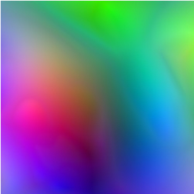
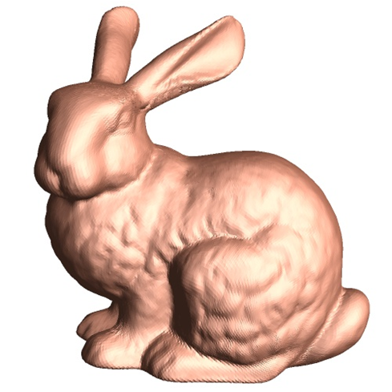
Geometry Images
What are they?
Simple mesh representation data structure
Encodes mesh geometry and connectivity in an image-like array
Vertices Positions
4 Neighbours = 1 Quad
257 × 257 Geometry Image
Reconstruction
Geometry Images Motivation Grid Alignment Sampling Remeshing Results Video Conclusions & Future Work
Notes:
So, if any of you are scratching their heads wondering what geometry images are, I am going to do a quick review of the original method, as described by Gu et al.
Geometry images are a simple mesh representation that encodes the geometry and the connectivity of a surface into an image-like array.
So each RGB pixel represents the XYZ position of a single vertex.
On the left, you can see an example a geometry image encoding the position of the stanford bunny.
Each group of four pixels creates a quad (well 2 triangles), so the connectivity is implicitely defined by the adjacency of the pixelss.
Geometry images are completely regular
Eliminates random lookups
Compact, connectivity is implicitely defined

Slide 4
Geometry Images
Why?
Rendering a typical irregular mesh data structures requires many random lookups
Geometry images are completely regular
Eliminates random lookups
Compact, connectivity is implicitely defined
Geometry Images Motivation Grid Alignment Sampling Remeshing Results Video Conclusions & Future Work
Notes:
There a several reason why this data structure is interesting.
Let’s look at a simple irregular mesh data structure (irregular = variable number of neighbors, similar to HW vertex/index buffers)
Suppose we want to render F2 (green triangle).
We would need three random lookups to fetch the vertex positions.
And even more if we have additionnal attributes (normals, uvs, etc.)
In practice, this operation is optimized via vertex caching in HW.
And one last thing is that we can apply image processing algorithms to them.

Slide 5
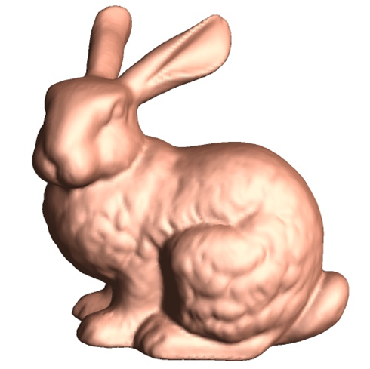
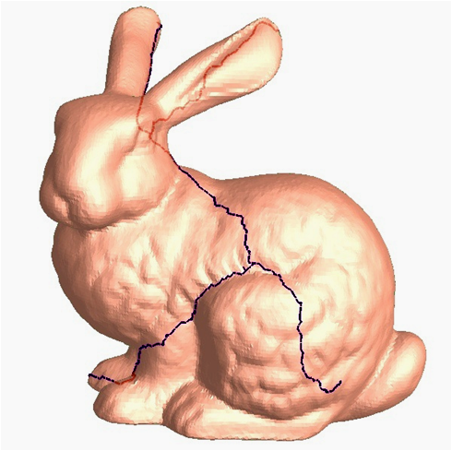
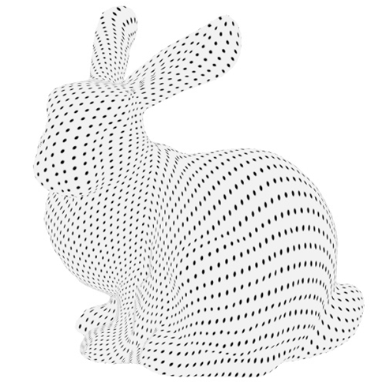
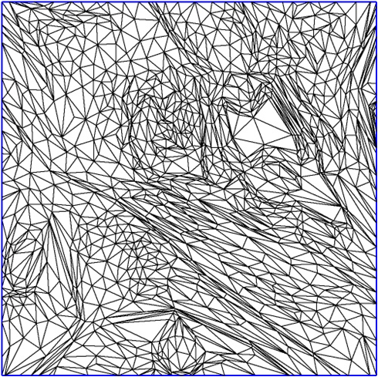
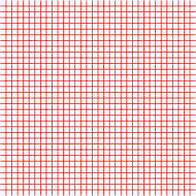
Geometry Images
How to create them?
Original Model
Cut
Sampling
Geometry Image
Parameterization
Sampling Grid
Reconstruction
Geometry Images Motivation Grid Alignment Sampling Remeshing Results Video Conclusions & Future Work
Notes:
So, we have an input model and we want to generate a geometry image.
In order to flatten the bunny on the plane, we need to cut it to make it topologically equivalent to a disk and they parameterized inside the unit square.
The parameterization is sampled using a regular grid to retrieve the surface positions.
You can see the sample position on the model surface.
Each sample is stored in the image.
Finally, from the image, we can easily reconstruct our resampled version of the original bunny.
Following the same procedure, other surface attributes such as normals can be sampled and stored in other images.

Slide 6
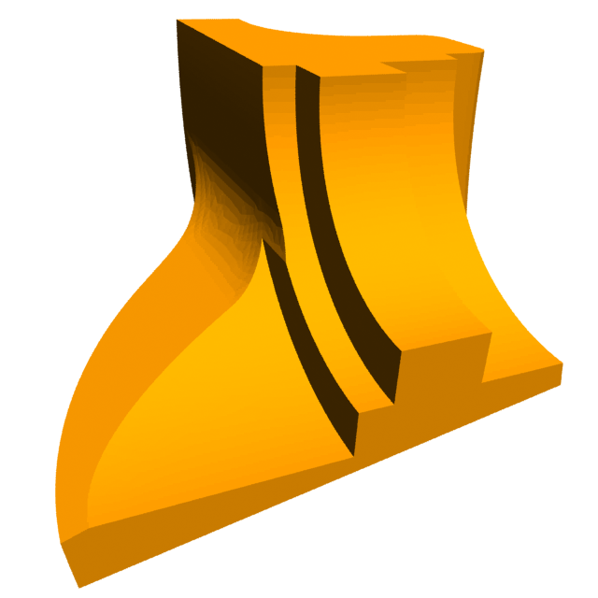

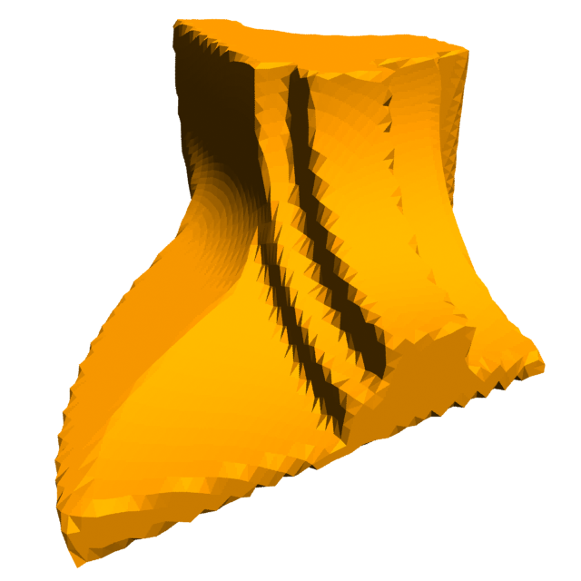
Motivation
The problem
…And there in lies the problem: The regular grid used to sample the parameterization cannot capture sharp features
Geometry Images Motivation Grid Alignment Sampling Remeshing Results Video Conclusions & Future Work
Notes:
It works pretty well on our bunny because it is a very smooth surface.
Lets see what happens with a surface containing both sharp and smooth features.
Se parameterize it, create the geometry images and try to remesh it from the images.
It becomes clear that the regular sampling grid fails to capture the sharp edges present of a surface.
We are using flat shading so that the orientation of the faces is more visible.

Slide 7
Motivation
One solution
Add constraints such that sharp features align with the sampling grid in the parameterization domain
It makes the process very difficult to converge
Non-linear, energy function is not smooth, infinity or no good solution
Geometry Images Motivation Grid Alignment Sampling Remeshing Results Video Conclusions & Future Work
Notes:
One solution to this problem would be to add constraints during the parameterization procedure so that sharp features align with our regular sampling grid.
In practice, this is very difficult to formulate such constraints using a generic black box solver.
The procedure is non-linear and the function is not smooth. There might be an inifinity of “good” solutions and there might also be configurations where there is no valid configuration at all.
As the number of sharp features increase, the choice of a good parameterization becomes much more complex.

Slide 8
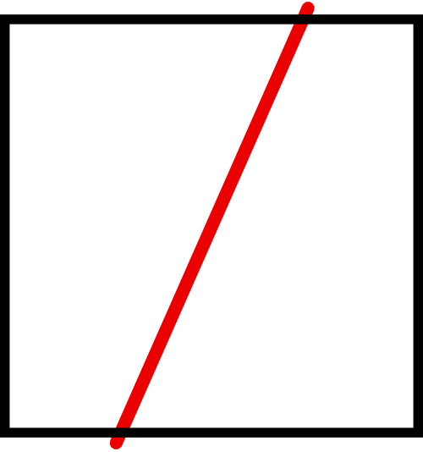
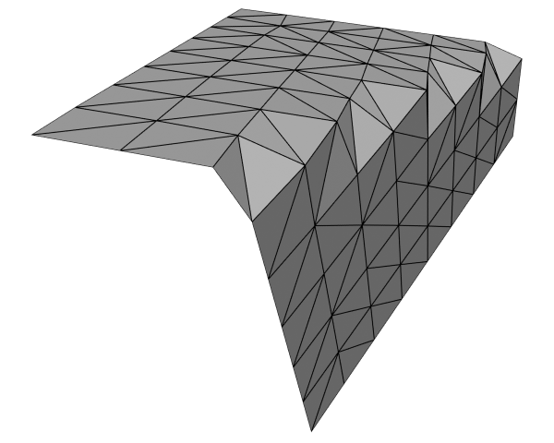
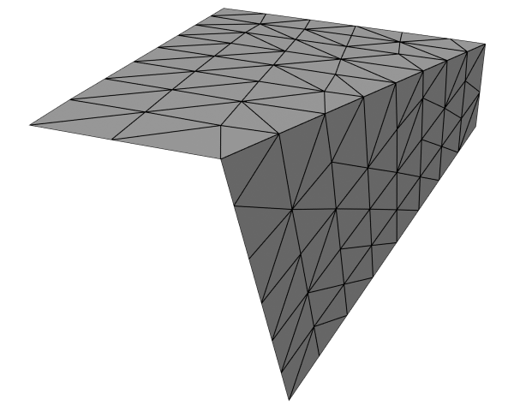
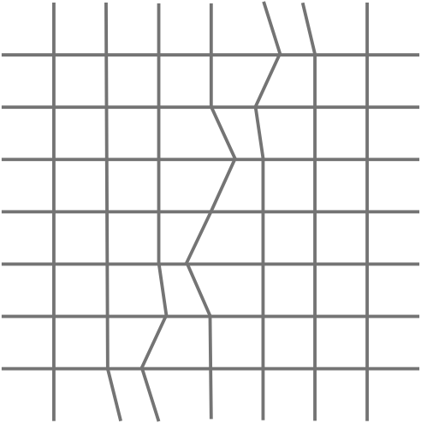
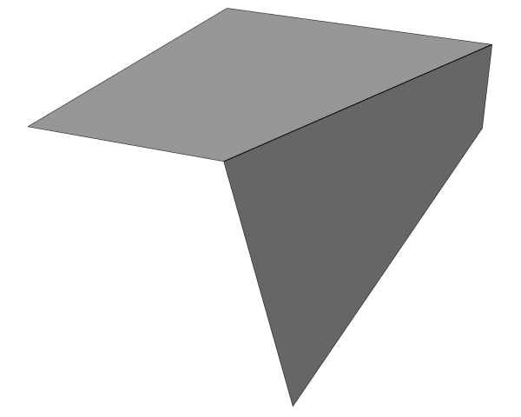
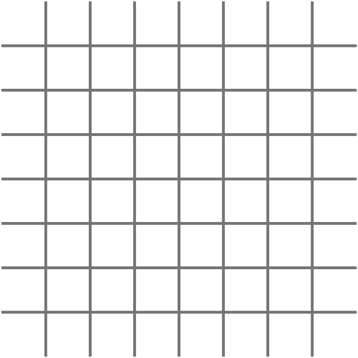
Motivation
Simple example
Slightly perturbating the grid, such as done in dual contouring [JLSW02], might simply and more easily resolve some alignment problems
Geometry Images Motivation Grid Alignment Sampling Remeshing Results Video Conclusions & Future Work
Notes:
On the other hand, if we slightly modify our regular grid to better align if with the sharp features present on the surface, we might be able the fix the problem more easily.
Let’s look at a simple plane with one sharp edge in red. This is in parametric-space.
If we were to resample this using our regular grid, we would get something like this as a remeshing.
We can observe that every time a sharp edge crosses an edge of our sampling grid, it gets improperly reconstructed.
Now, if we very naively slide the sample points left and right to align them with our edge in red, we get something much better.
This simple idea will be the basis of our method.

Slide 9
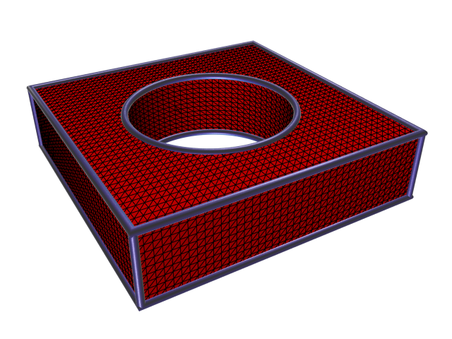
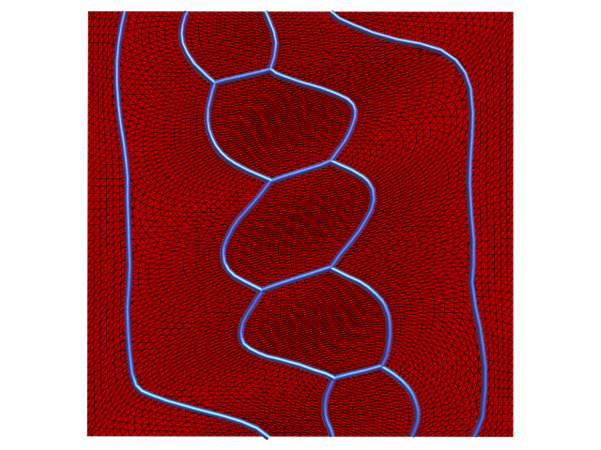
Grid Alignment to the Sharp Features
Identifying sharp features
Input 3D Model
Parameterization
Sharp Edge
Sharp Corner
Chain of Sharp Edges = Sharp Segment
Geometry Images Motivation Grid Alignment Sampling Remeshing Results Video Conclusions & Future Work
Notes:
So, lets start from the beginning, we have an input model and a parameterization on the unit square.
We identify sharp edges using a simple dihedral angle threshold, but other information, such as smoothing groups could be used as well.
We call a sharp edge an edge where the dihedral angle is larger than the threshold
We call a corner, where 3 or more sharp edges meet
We call a sharp SEGMENT, a connected chain of sharp edges.
So this object has 8 sharp corners, 14 sharp segments and many sharp edges.

Slide 10
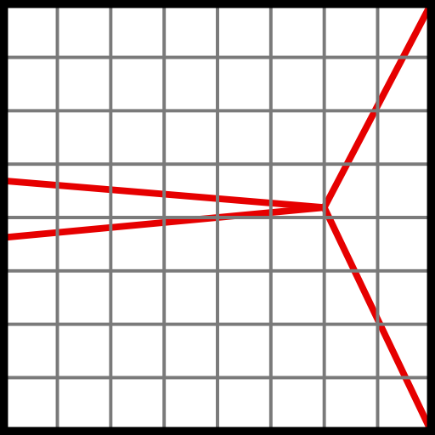
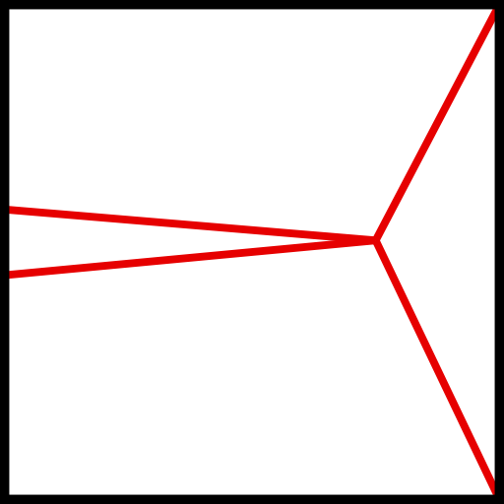
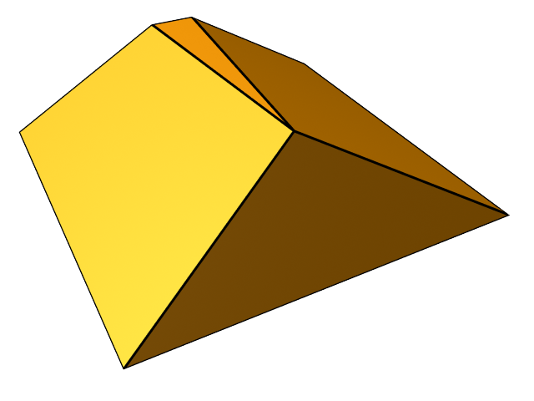
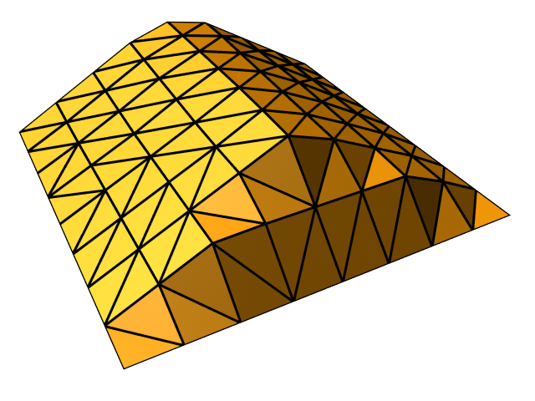
Grid Alignment to the Sharp Features
Corner & Edge Snapping - Part 1
Geometry Images Motivation Grid Alignment Sampling Remeshing Results Video Conclusions & Future Work
Notes:
So, to explain the first part of the algorithm, we will use this rooftop shape.
On the right, we have the parameterization, where the model has basically been flattened on the plane. The sharp edges are in red.
Just to prove our point again, if we remesh this using a regular grid, we would loose a lot of details.
PP: as shown on the reconstructed model on the leftpeut-etre que tu devrais aussi montrer le modele original avec ses sharp features.

Slide 11
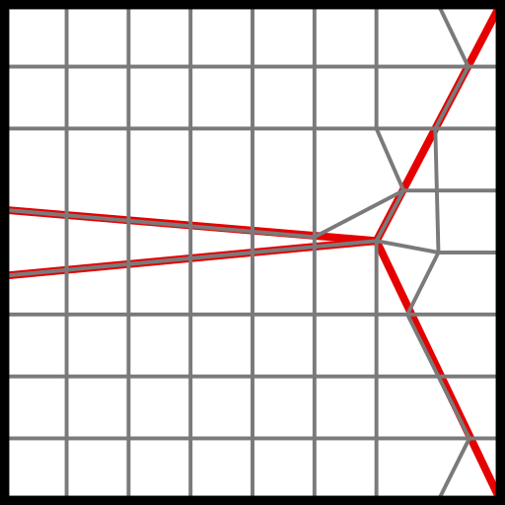
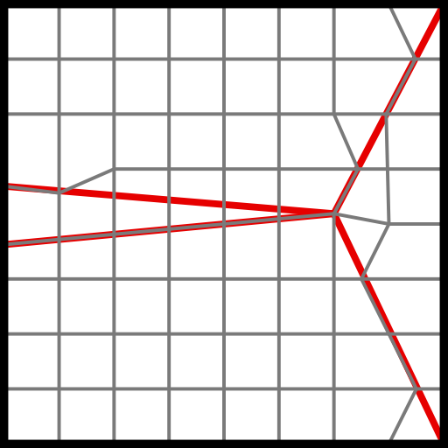
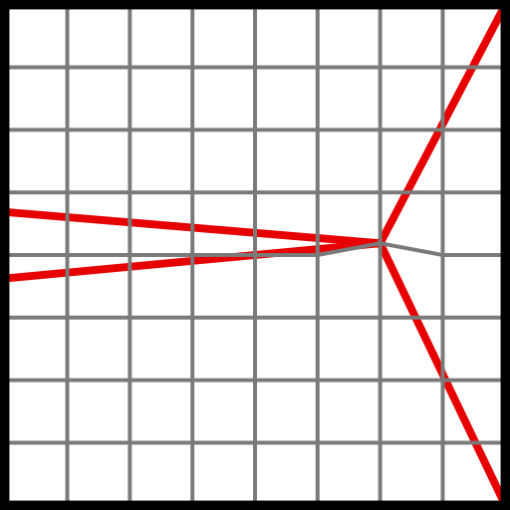
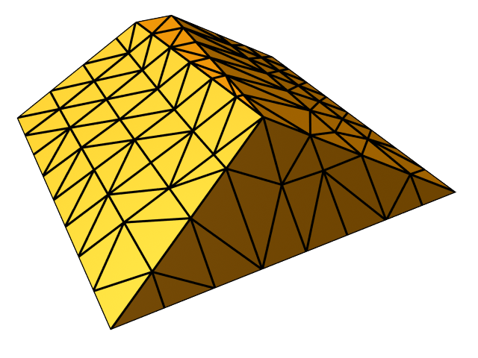
Grid Alignment to the Sharp Features
Corner & Edge Snapping - Part 2
Geometry Images Motivation Grid Alignment Sampling Remeshing Results Video Conclusions & Future Work
Notes:
We believe sharp corners are especially important to preserve the appearance of the original surface, so we process them first.
In the first step, we process each sharp corner and we locate the grid vertex that is the closest. In this case, there is only one corner.
Once a closest vertex has been identified for each corner, we move the closest vertex to the position of the corner.
Note that once a sample has been moved, it will never move again.
Edges are processed in two steps.
We first locate the 2D intersection between all sharp edges and grid edges.
At each intersection, two vertices could be moved to properly sample the sharp edge.
For each sample point, we keep track of the closest edge/edge intersection point.
When all intersections have been processed, we move the samples to the closest intersection found.
At the end of this pass, there may still be edge/edge intersections left, so we repeat the process but don’t consider the vertices that have already been snapped.
Now we have the final grid.

Slide 12
Grid Alignment to the Sharp Features
Corner & Edge Snapping - Part 3
Geometry Images Motivation Grid Alignment Sampling Remeshing Results Video Conclusions & Future Work
Notes:
Now let’s look at our remeshed rooftop using our modified grid, looks much better.

Slide 13
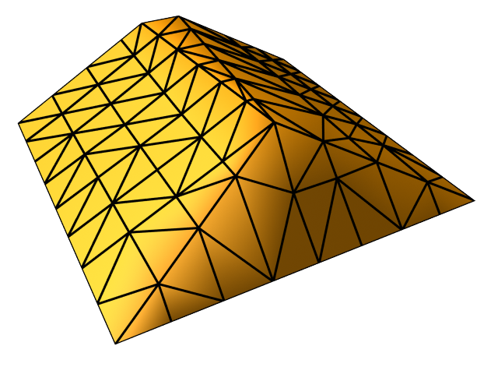
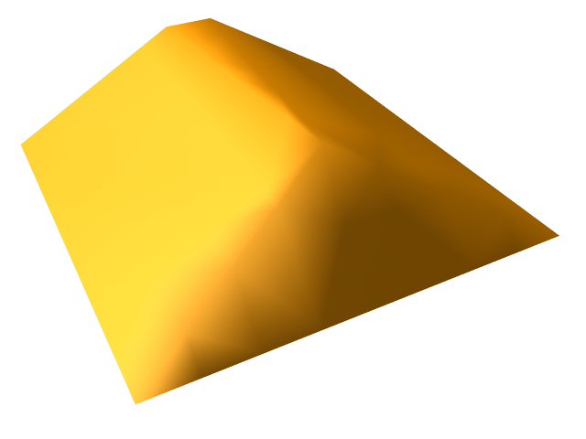
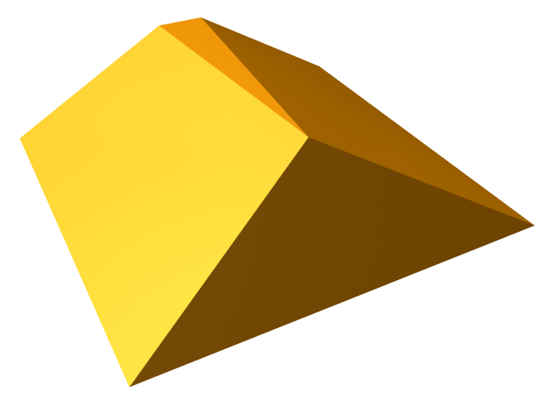

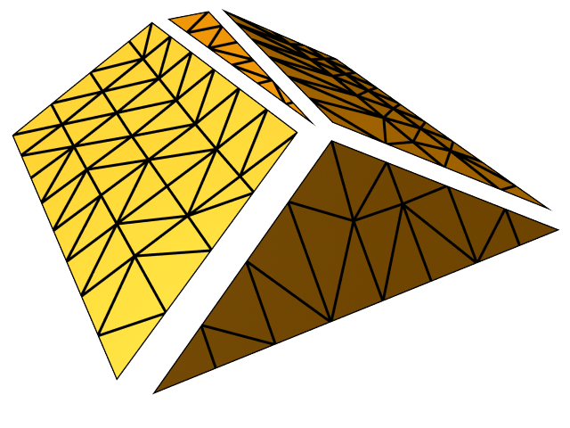
Sampling
What about UVs and normals?
UVs coordinates are no longer implicit
We can no longer use 1 normal per vertex, we need more, especially for lighting.
Geometry Images Motivation Grid Alignment Sampling Remeshing Results Video Conclusions & Future Work
Notes:
So we have added an extra step to the original algorithm, what are the implications?
Well first, using a regular grid has the nice property that the UV coordinates of the geometry image vertices are implicit, because they coincide with their position in parametric space.
When we modify the grid, this is no longer the case for all vertices, so we will need to store that information somewhere else.
Also, we have done a good job to sample sharp corners and edges, but if we really want to preserve sharp features, we will need to sample more than one normal per vertex.
For example, a vertex sitting on a sharp edge requires 2 normals, and for the corner on the top, we need 4.

Slide 14
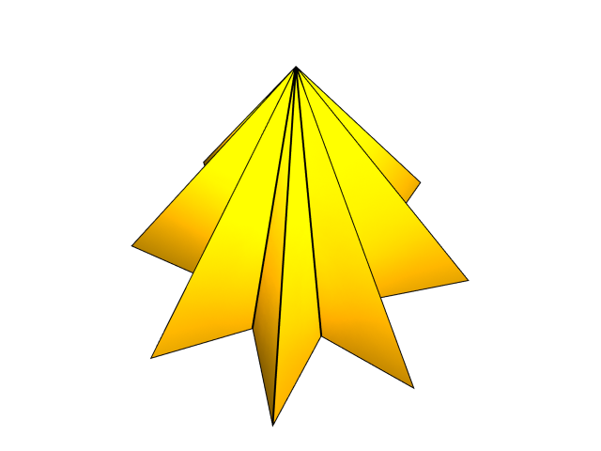
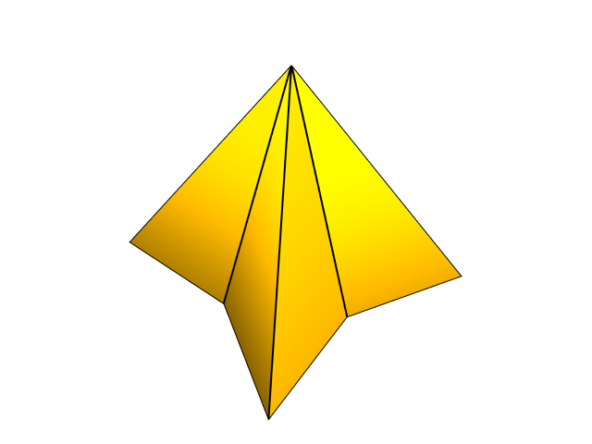
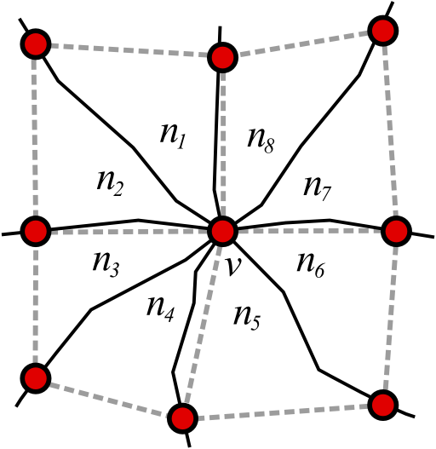
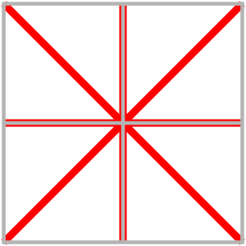
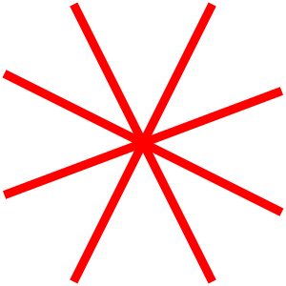
Sampling
Normals
Because of the regular structure of the geometry image and the way we remesh, we will never need more than 8 normals around a vertex (one per octant)
Geometry Images Motivation Grid Alignment Sampling Remeshing Results Video Conclusions & Future Work
Notes:
Because of the regular structure of a geometry image, we will never need more than 8 normals around a vertex.
In this example, there could be more sharp edges connected to the center vertex, but on 8 can be effectively sampled at this resolution using our algorithm.
So using this observation, we choose to simply store 8 normals per vertex, one per octant, allowing redundancy where less than 8 are needed.
Any encoding could be used, but we feel this method is pretty much in line with the phylosophy of the geometry image.
Here you can see numbering the convention we used for the octants.

Slide 15
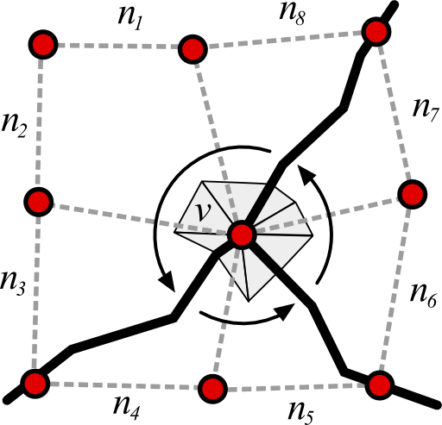
Sampling
Normals of Corners
To sample the normals around a sharp corner, we simply iterate in CCW order between sharp edges, compute the angle-weighted normal and assign it to all the associated octants
Geometry Images Motivation Grid Alignment Sampling Remeshing Results Video Conclusions & Future Work
Notes:
For a given sharp corner, we know the outgoing sharp edges and we can trace to see to which neighbor samples they are connected.
Knowing that, we iterate between pairs of sharp edges and compute the angle-weighted normal of all the swept faces
We copy this normal to all the associated octants.
In this example we would compute 3 different normals, one would be copied to n8-n1-n2-n3, another one to n4-n5 and the last one to n6-n7.

Slide 16
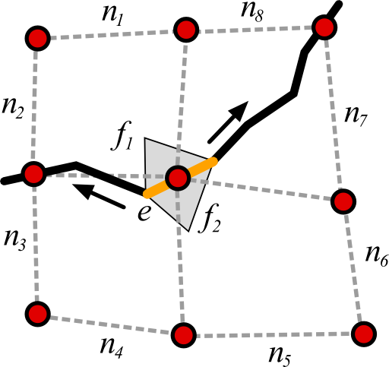
Sampling
Normals of Sharp Edges
For a sample snapped to a sharp edge, the procedure is very similar, only two normals will be computed and stored, in the respective octant
Geometry Images Motivation Grid Alignment Sampling Remeshing Results Video Conclusions & Future Work
Notes:
Again, we can iterate in CCW order from one of the two edge vertex to compute the two normals and find out into which octants they should be copied

Slide 17
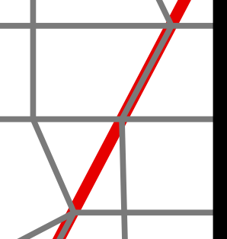
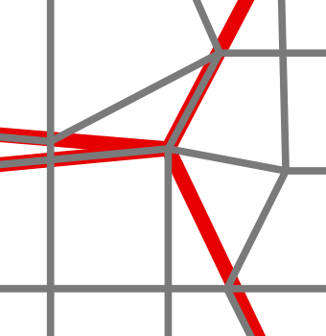
Sampling
Back to Our Example
8
1
7
2
3
6
4
5
Geometry Images Motivation Grid Alignment Sampling Remeshing Results Video Conclusions & Future Work
Notes:
Back to our example, let’s look at the only corner and its neighborhood.
Altough it is a little distorted, we can see the 8 octants around the vertex.
We iterate in CCW order and compute the normal and store in the the appropriate octants.
In this case, we have 4 normals, the first one covers octant 1, the 2nd one octant 2, the 3rd one octants 3, 4 and 5 and the last one octants 6, 7 and 8.

Slide 18
Sampling
Back to Our Example
8
1
7
2
3
6
4
5
Geometry Images Motivation Grid Alignment Sampling Remeshing Results Video Conclusions & Future Work
Notes:
Let’s look at an edge vertex of our example.
The first normal gets store in octants 1, 2 and 3 and the 2nd normals goes to the remaining octants.

Slide 19

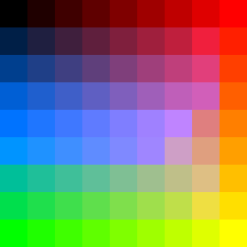
Sampling
Result
1 Position Image (9x9)
8 Normal Images (9x9)
Geometry Images Motivation Grid Alignment Sampling Remeshing Results Video Conclusions & Future Work
Notes:
Here is the final output of our sample, 1 position image and 8 normal images.
It is important to note that is is also possible to sample normals at a higher resolution than the position images.
There are special consideration when doing this, but the algorithm still works very well.

Slide 20
Remeshing
Algorithm
Remeshing from geometry images is very similar to the original method
A vertex is created for each image pixel
For each group of four pixels, two triangles are created
…But since we have up to 8 normals per vertex, more vertices may need to be created
Faces must also be connected to the appropriate vertices
Geometry Images Motivation Grid Alignment Sampling Remeshing Results Video Conclusions & Future Work

Slide 21
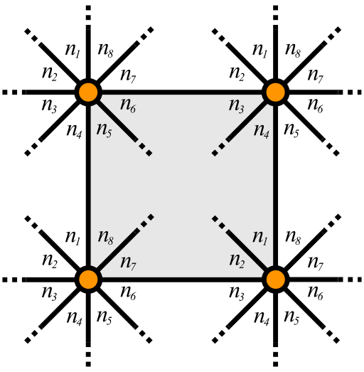
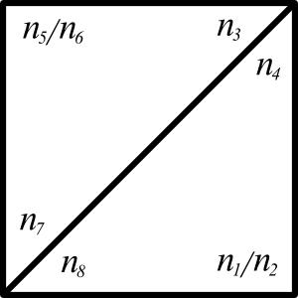
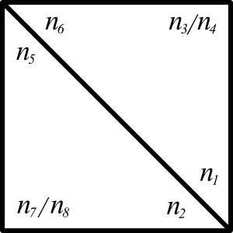
Remeshing
Algorithm
For each image pixel, we create as many vertices as there are different normals (up to 8) and store them in an array[8]
When creating the faces, we use the following rule to select which vertex to connect.
Geometry Images Motivation Grid Alignment Sampling Remeshing Results Video Conclusions & Future Work
Notes:
So here is our remeshing procedure.
(READ SLIDE)
There are basically two ways to triangle a quad, for each configuration, we use the following lookup table to decide which of the 8 normals to use.

Slide 22
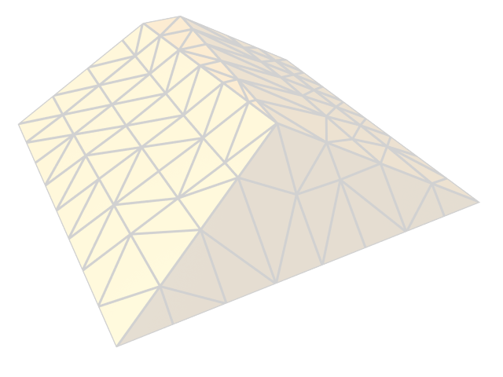
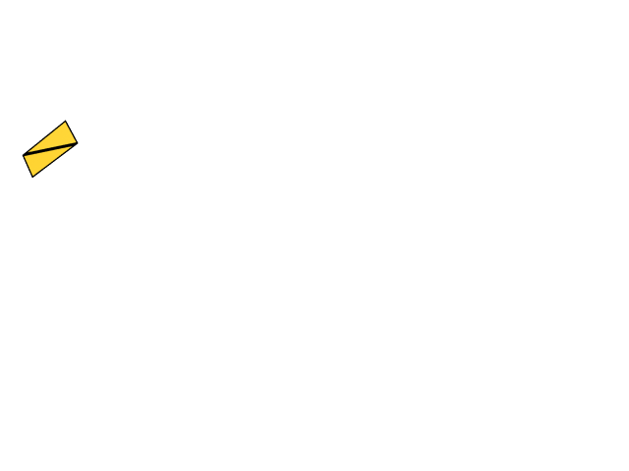
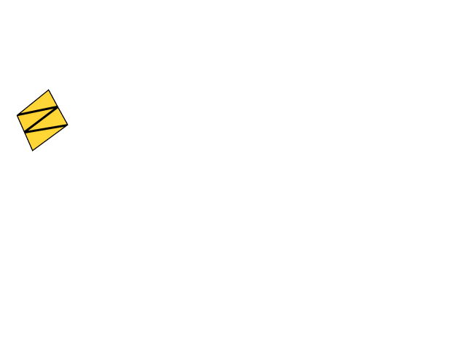
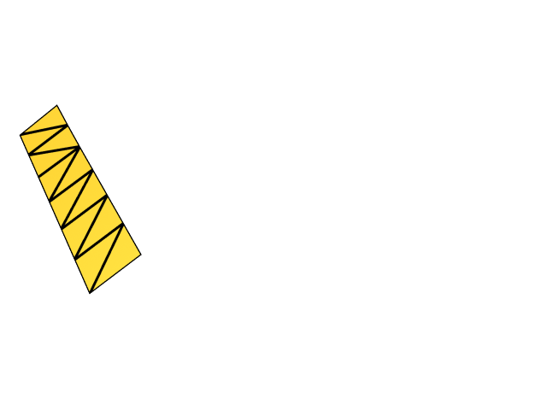
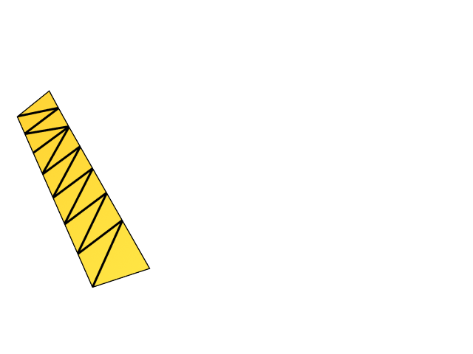
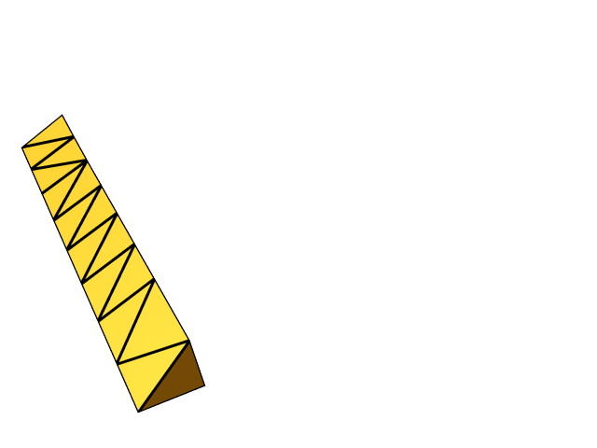
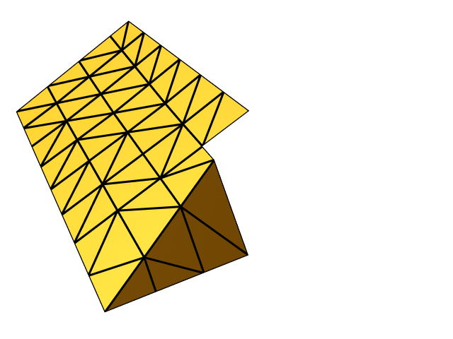
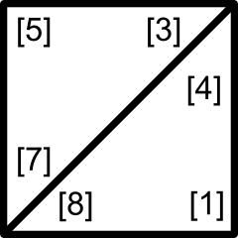

Remeshing
Example
Geometry Images Motivation Grid Alignment Sampling Remeshing Results Video Conclusions & Future Work
Notes:
Again, back to our example, let’s remesh the rooftop from the image.
We are only showing the position image, but you have to keep in mind that there are also 8 normals/pixel.
We first start by creating all the vertices , one for each pixel and as many as there are different normals.
We then procede to create the quads and connect to the appropriate vertex using our simple convention.
(Keep going).

Slide 23


Results
Square Torus (Original Model)
Geometry Images Motivation Grid Alignment Sampling Remeshing Results Video Conclusions & Future Work
Notes:
Let’s look at some results, first we have a simple square torus
… with the wireframe.

Slide 24





Results
Square Torus (Comparison)
Geometry Images Motivation Grid Alignment Sampling Remeshing Results Video Conclusions & Future Work
Notes:
Here you can see the difference that our algorithm makes at different resolutions.(65, 33, 17)

Slide 25


Results
Square Torus (Position and Normal images)
Geometry Images Motivation Grid Alignment Sampling Remeshing Results Video Conclusions & Future Work
Notes:
Here you can see what the GIMs look like.
For vizualisation purposes, the normal image is the average of all the 8 normal images.

Slide 26


Results
Fandisk (Original Model)
Geometry Images Motivation Grid Alignment Sampling Remeshing Results Video Conclusions & Future Work
Notes:
Here is the original fandisk model.
It is a very commonly used model in the field of remeshing because it contains both smooth and sharps edges and also transitions between the two.

Slide 27




Results
Fandisk (Remeshings)
129×129 Geometry Images
33×33 Geometry Images
Geometry Images Motivation Grid Alignment Sampling Remeshing Results Video Conclusions & Future Work
Notes:
Here is a 129x129 remeshing using our algorithm. It has about 3 times as much vertices as the original. All the sharp features are well reconstructed.
Here is a 33x33, even at such a low image resolution, with about 6 times less vertices than the orignal model, all the sharps edges are well preserved.

Slide 28


Results
Fandisk (129×129 Position and Normal images)
Geometry Images Motivation Grid Alignment Sampling Remeshing Results Video Conclusions & Future Work
Notes:
Here is the 129x129 position and normal geometry images.
Again, for vizualisation purposes, the normal image is the average of all the 8 normal images.

Slide 29






Results
CSG (Orignal Model and 257×257 Remeshing)
Geometry Images Motivation Grid Alignment Sampling Remeshing Results Video Conclusions & Future Work
Notes:
On the left, we have the original model and on the left the reconstruction from the 257x257 geometry images.
And with the wireframe visible.
The wireframe is pretty small so here is a zoom in.

Slide 30


Results
257×257 Positon and Normal Geometry Images
Geometry Images Motivation Grid Alignment Sampling Remeshing Results Video Conclusions & Future Work
Notes:
Again the 257x257 position and averaged-normal images.

Slide 31
Results
Video
Start!
Geometry Images Motivation Grid Alignment Sampling Remeshing Results Video Conclusions & Future Work
Notes:
Do we have enough time?

Slide 32
Conclusion
Wrap up
Simple and efficient technique
Does not over-constrain the parameterization process
Can be added to any geometry image generation pipeline
Can only encode a maximum of 8 normals
Must store these 8 normals and 1 uv coordinates
Geometry Images Motivation Grid Alignment Sampling Remeshing Results Video Conclusions & Future Work
Notes:
Let’s wrap up this presentation, on the plus side, we presented a simple and efficient technique,
that does not add any constraints on the parameterization algorithm
and that can be integrated into any GIM generation pipeline.
On the other hand, our technique can only preserve up to 8 normals around a vertex.
And our simple storage method for the normals is pretty expensive since it has a lot of redundancy.
But could be compressed.

Slide 33
Future Work
Once the grid is snapped to sharp features, it may be possible to add an extra relaxation step to deform the parameterization and bring back the grid to a regular shape
Try something other than a greedy algorithm, maybe something like a quadric error metric could help find a better overall solution
Geometry Images Motivation Grid Alignment Sampling Remeshing Results Video Conclusions & Future Work

Slide 34
Thank You!
Questions? Comments?
Geometry Images Motivation Grid Alignment Sampling Remeshing Results Video Conclusions & Future Work

