Slide 1
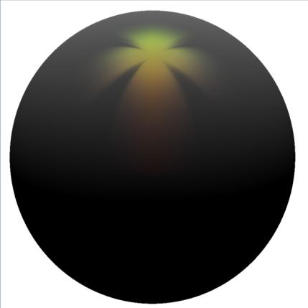
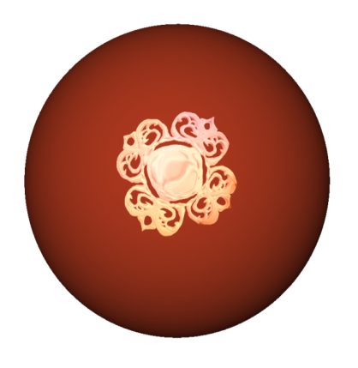
Sketch and Paint-based Interface
For Highlight Modeling
Romain Pacanowski
Xavier Granier
Christophe Schlick
Pierre Poulin
INRIA Bordeaux University

Slide 2
Highlights
Motivation
Important for the final appearance
Local function of view and light direction:
Large range of effects

Slide 3
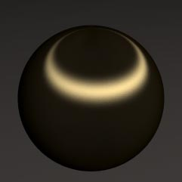
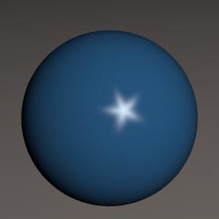
Highlight Classification
Motivation
Realistic
Plausible
NPR
[Ward 92]
Physic-based
Stylized
[Ashikhmin 00]
OUR APPROACH
[Anjyo 06]
User Control
User Control Friendliness
None
Complete

Slide 4
The Highlight Function
Context
Local
Complex 4D Function
View ( ) and Light ( ) dependent
How to control a 4D Function ?

Slide 5
Realistic Context
Previous Work on Highlight Modeling
Pre-defined Models [Pho75,Bli77,War92,...]:
Non-intuitive choice ☹
Non linear parameters’ behavior ☹
Limited edition freedom ☹
Painting Highlight
Directly [Poulin95,Colbert06]
Easy and intuitive interface ☺
Edition freedom limited ☹
Indirectly [EBJ*00,APS00,NNSK99]
Distribution of normal = not intuitive ☹
Colbert 06

Slide 6
Non-Photorealistic Context
Previous Work on Highlight Modeling
Lit Sphere [SMGG01]
Limited to fixed lighting ☹
Anjyo et al. [AWB06]:
Design the light shape (≠ highlight)
No color and glossiness edition ☹
Todo et al. [TABI07]:
Highlight per light key-directions ☺
Limited to stylized shading ☹
Anjyo 06

Slide 7
A new system for highlight design
Motivation
Intuitive and flexible (targeted for artists)
Painting and Sketching tools
Interactive with real time user feedback
GPU friendly system
Large range of various appearances
Shape, Color and Gradient control
Smooth variations with light directions

Slide 8
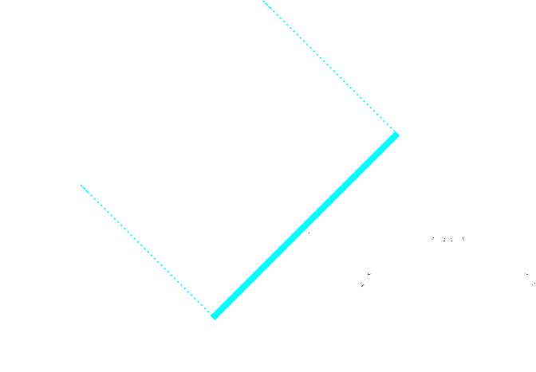
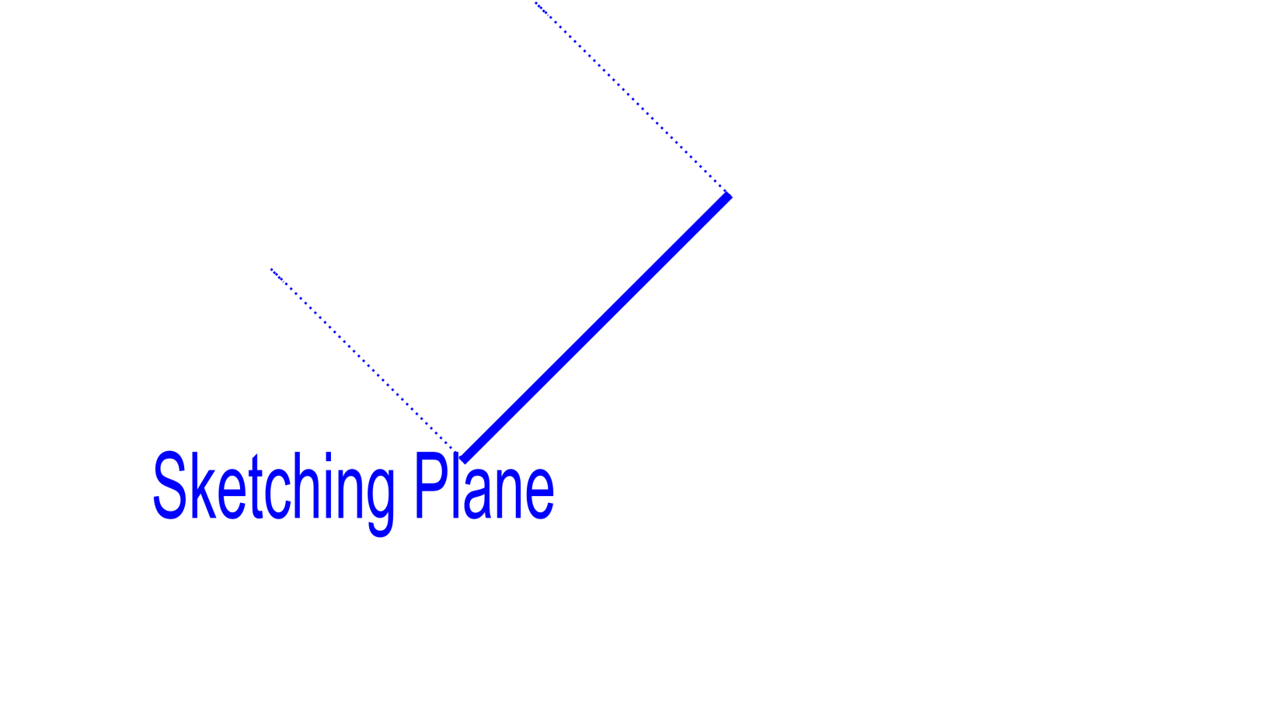
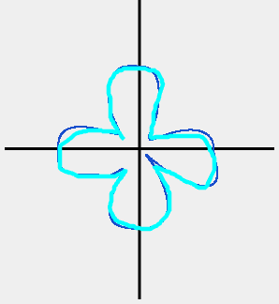
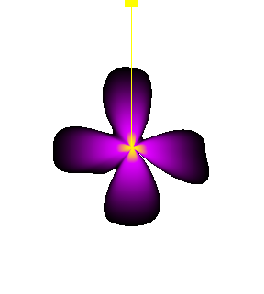
Sketching and Painting
Our Method
Color and Gradient
Shape
+
=
Sketching Plane
Sketching
Shape
Painting
Color
Result

Slide 9
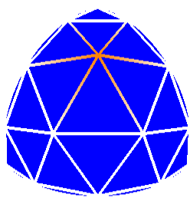
Interpolation between light key-directions
Our Method
Spherical Mesh
Vertex = light key-direction
Between key-directions
Shape interpolation
Color interpolation

Slide 10
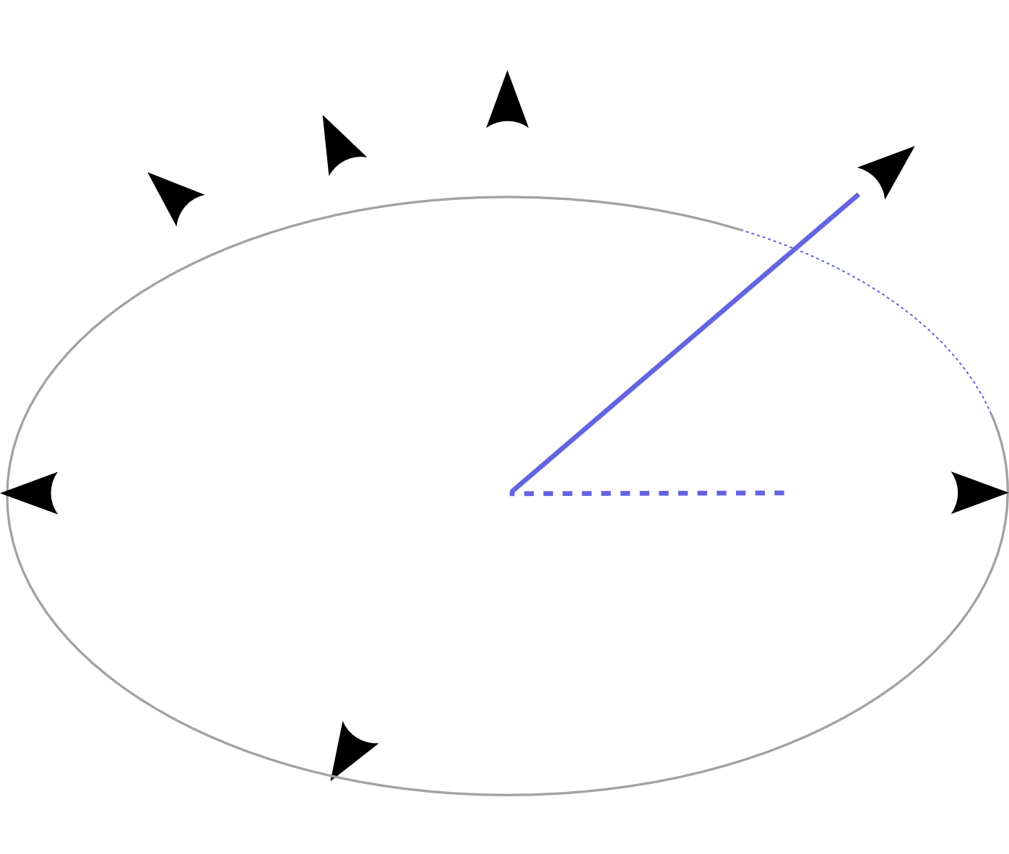
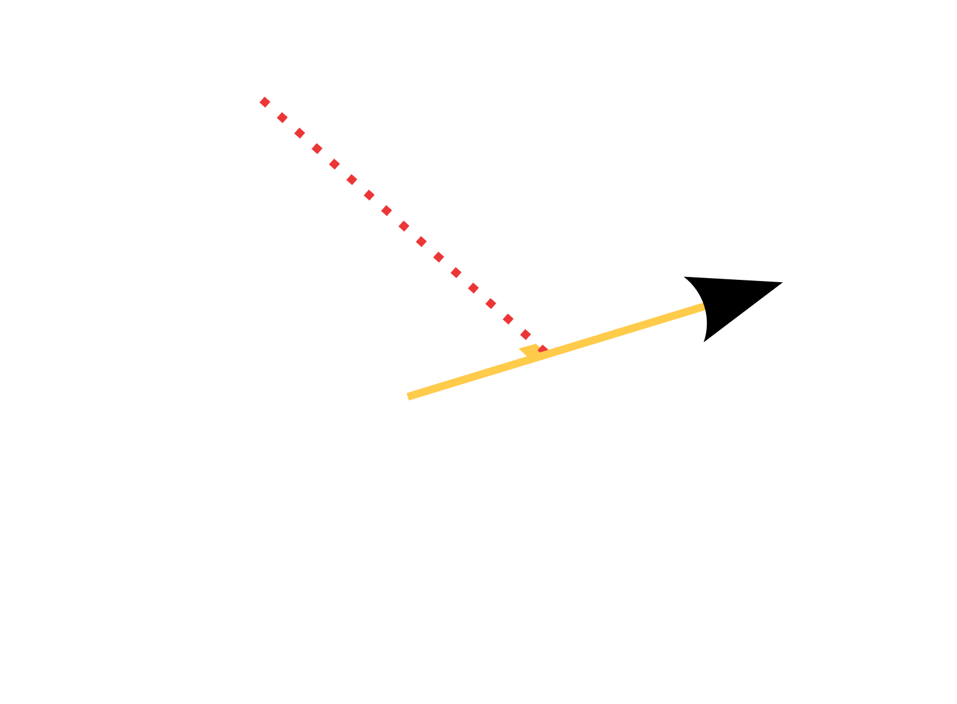
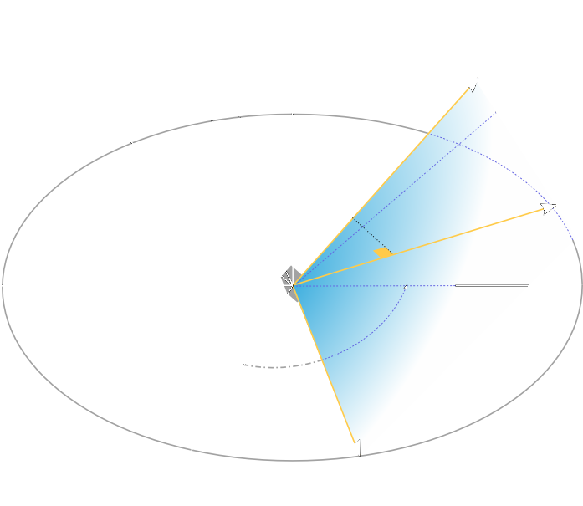
Parameterization of the Sketching Plane
Highlight Representation
Notes:
Define ρ and θ according to V and L to define a highlight function :

Slide 11
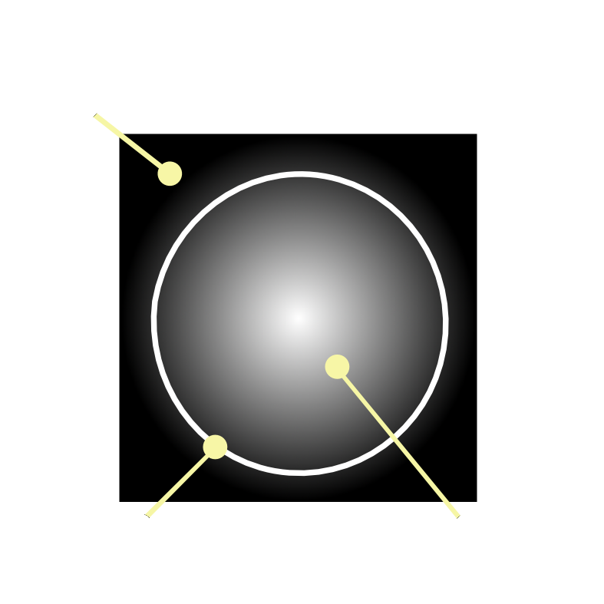
Shape
Highlight Representation
Spline based polar curve
Highlight boundary
Distance field
Shininess control

Slide 12
Color and Gradient
Highlight Representation
Texture
Defines the highlight intensity where
Black texel => highlight intensity = 0
Glossiness control
Color Gradient
Color Texture
Notes:
Polar or Cartesian coordinates access

Slide 13
More Complex Shape
Highlight Representation
Two multiplicative layers to define the color texture:
×
Highlight Color
Highlight Intensity
Notes:
Classical 2D pen and brushes

Slide 14
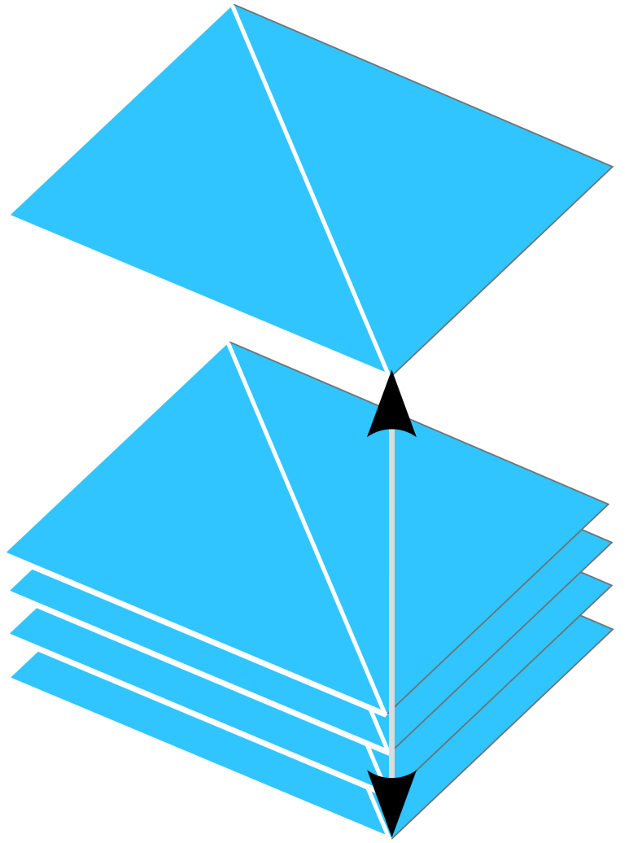
GPU Structures
Highlight Representation
Polar Curve
K control points
Control point radius
3D Texture
Color and Gradient
One 2D texture per light key-direction
Spherical Triangle
Notes:
Geforce 8 = Texture arrays possible to pack the Color texture

Slide 15
Main View
User Interface
Highlight gradient and color
Painting and Gradient editing
Highlight on the sketching plane
Editing by painting
Highlight main Shape
Curve Sketching
Light key-direction
Feedback on the currently selected light direction

Slide 16
Highlight Modeling Features
Results

Slide 17
Light key-directions with same shape
Results

Slide 18
Bitmap Deformation
Results

Slide 19
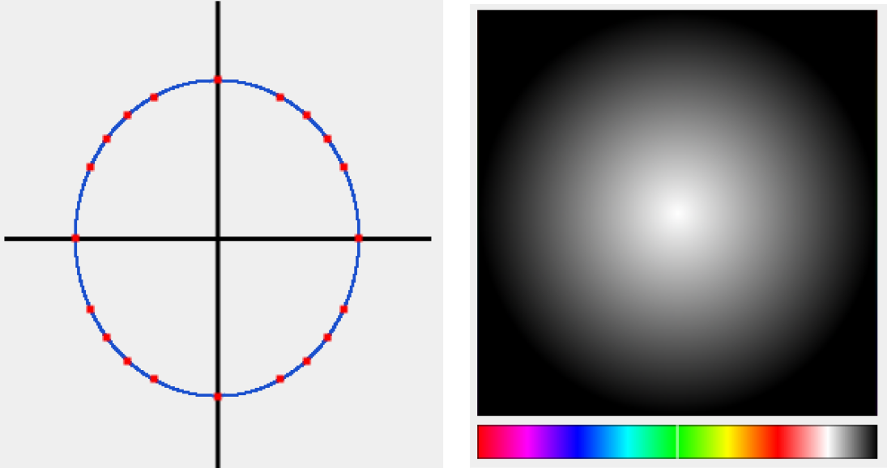
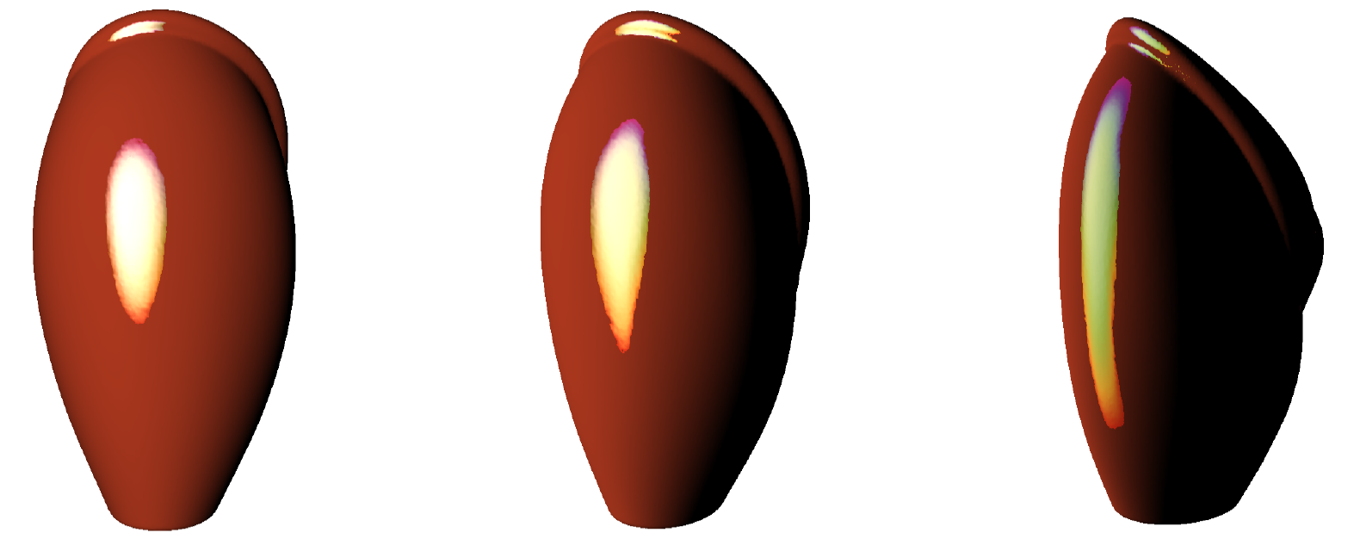
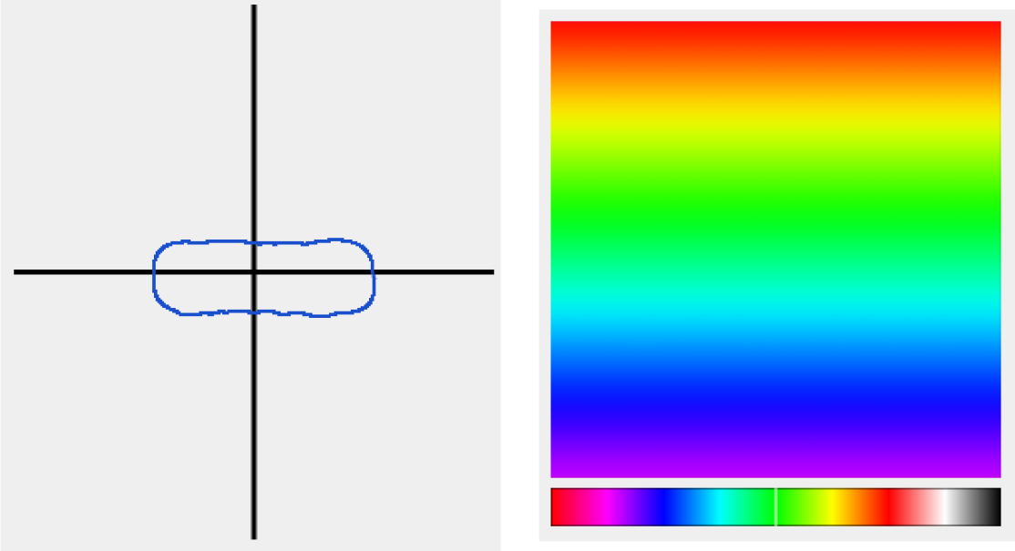
Light key-directions with different shape
Results
Normal Incidence Configuration
Grazing Incidence Configuration

Slide 20
Summary
Conclusion
System for highlight design
Painting and sketching metaphors
Highlight
Shape : Polar Curve
Color and Gradients : 2D Texture
Real Time solution
Large variety of highlights
More intuitive than previous approaches
Notes:
WARNING ➔ MORE INTUITIVE : NO USER STUDIES !!!

Slide 21
Limitations and Future Work
Color textures Interpolation
Morphing interpolation
Strong normal variations
Strong highlight variations
Spatially varying highlight
Geometry dependent highlight
Painting in a plane
Deformations on 3D object
Easier to paint on 3D object directly

Slide 22
Limitations and Future Work
Not physically correct
If needed : normalization
Extension to complex illumination
Spatial tools to clone and position highlight

Slide 23
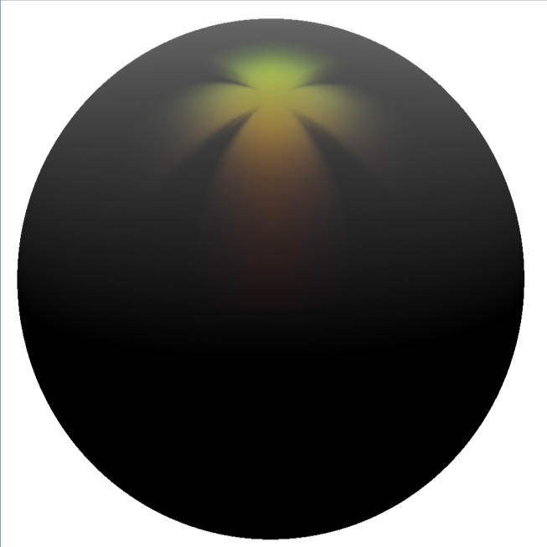
Questions?

Slide 24
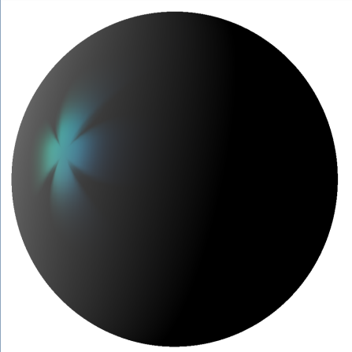
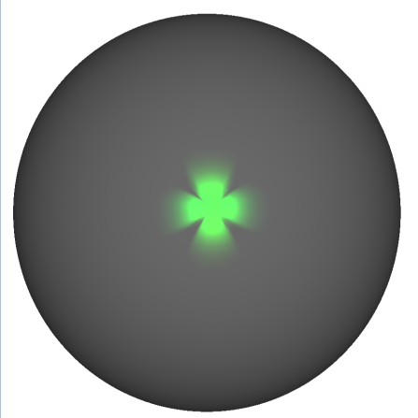
Overview
Our Method
Highlight = Function of light and view direction :
Main idea:
For a chosen L:
Light key-direction
User sketches and paints highlight
Sketching Plane
For others : let the system interpolate the result

